Slide 1
MarketingGuru
Software Engineering
Faculty of Engineering
Ben Gurion University of the Negev

Slide 2
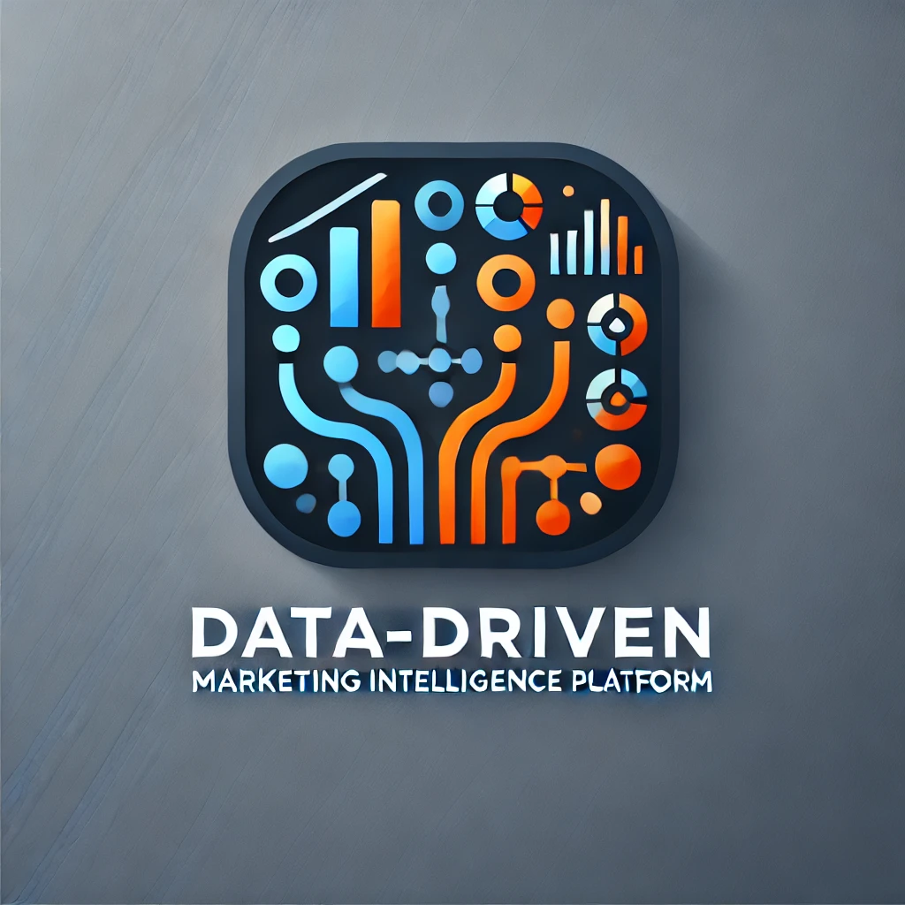
Team Details
Student Name | ID | Email | Phone | Signature
Evyatar Kopans | 209130335 | kopansev@post.bgu.ac.il‏ | 052-790-3414
Yuval Goldstein | 208668442 | golyuval@post.bgu.ac.il | 052-725-2886
Ron Franco | 206556045 | ronfr@post.bgu.ac.il | 055-954-2077
Peleg Ben Barak | 207233560 | benbapel@post.bgu.ac.il | 050-679-2401

Slide 3
Customer:
User1st
User1st’s Representative: Ariel Orbach
Role: Co-Founder CTO
Email: ariel.orbach@user1st.com
Phone: Number +972-(0)5203000970
Address: Azrieli Sarona Tower - Derech Menachem Begin 121, Tel Aviv-Yafo
Other advisors will also be appointed for specific purposes such as: CMO, Product Department, Compliance, Backend & Frontend architects, infrastructure / DevOps / SRE / Data / Sales)

Slide 4
Introduction
"Without data, you're just another person with an opinion." – William E. Deming.
The concept of an Ideal Customer Profile (ICP) has been a cornerstone of marketing for decades. Basically, it's the answer to the question "Who will buy my product/ services?".
In today’s competitive world, where sales are as essential to companies as air is to life, data-driven methods have revolutionized marketing, transforming it into a precise, measurable, and highly impactful discipline. These advances allow businesses not only to understand their customers better but also to craft strategies that resonate deeply and deliver tangible results.
Because at the end of the day, every company is a marketing company. Whether you sell software, shoes, or services, success depends on how well you understand your customers and meet their needs.

Slide 5
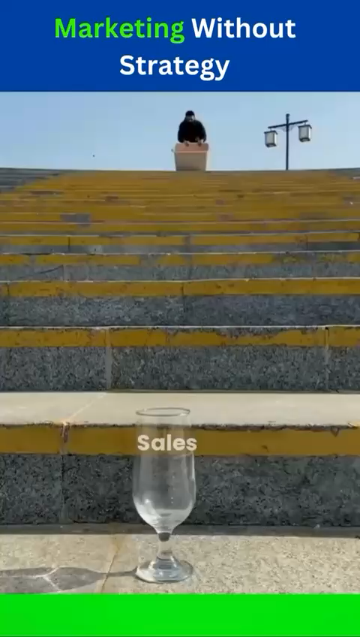
What “Marketing to everyone” gets you:

Slide 6
Project Motivation
The marketing domain has shifted from intuition-based decision-making to data-driven approaches.
What do we want to achieve?
Enhanced lead generation quality!
Increased customer engagement!
Improved product development
and positioning!
Search engine optimization!

Slide 7
Our solution
A Data-Driven Marketing Intelligence Platform, called “MarketingGuru”!
Our system aims to solve the problems of intuition-based approaches by gathering and analyzing important user data (Lead Analysis) in Order to assemble an accurate ICP.

Slide 8
Functional Requirements
Alpha version implementation
Integration for Cross-Platform Posting
Landing Pages System
Data Retrieval
Data Visualization
Campaign Performance Tracking – measuring success of a campaign by metrics such as CPC, CPL, MQL, SQL Tracking and Cost Per Customer
6. Data Privacy and Security

Slide 9
Functional Requirements
Extension points
Customer Profiling - Heuristic Definition, Lead Scoring.
Campaign Performance Tracking - Funnel Visualization, Customer Insights in Dashboard
Use an AI model with all our collected data to grant the lead Score for each user.
ROI analysis and stopping point calc per campaign (online algorithms – check).

Slide 10
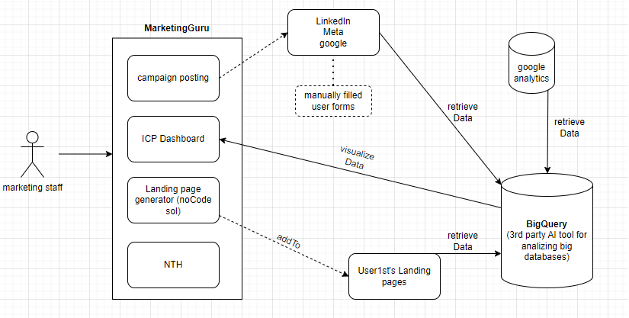
MarketingGuru

Slide 11
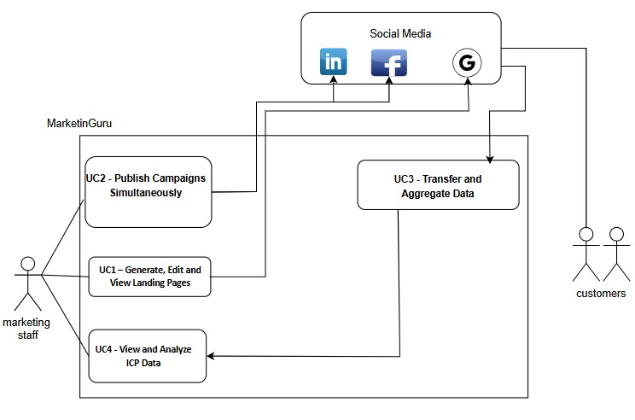
MarketingGuru

Slide 12
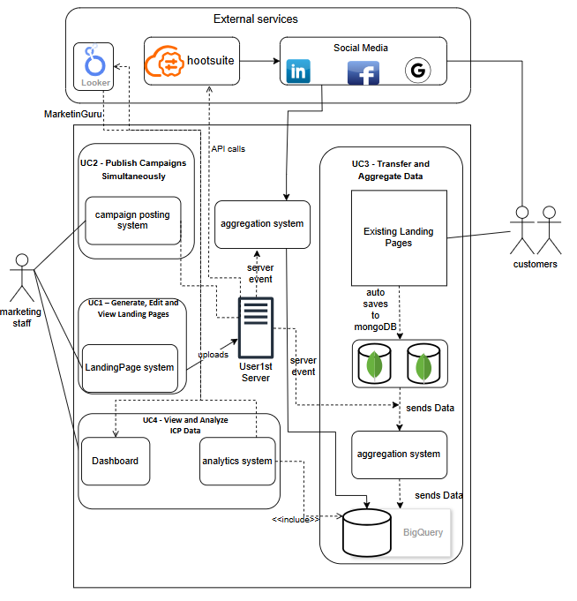
Detailed Design

Slide 13
Campaign Posting
How does it work?
Peleg drawing

Slide 14
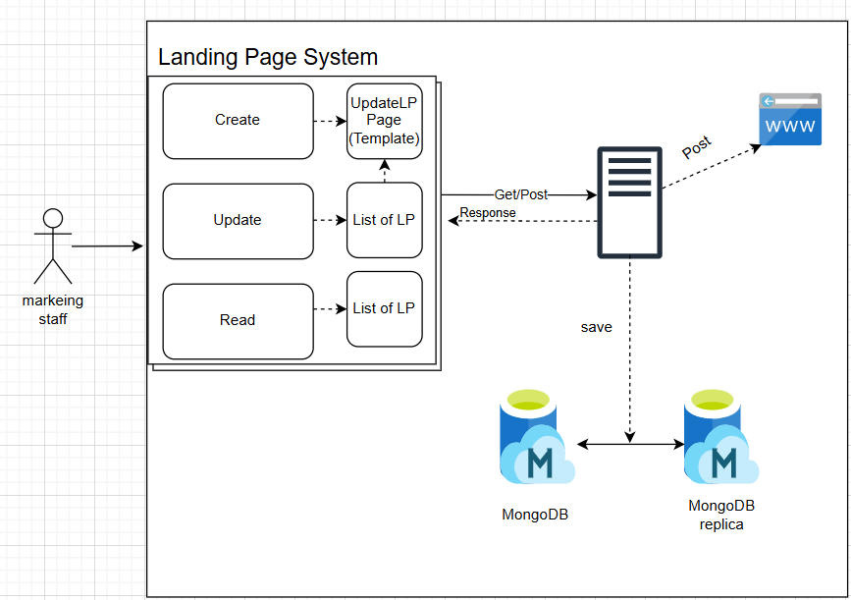
Landing Page System
How does it work?

Slide 15
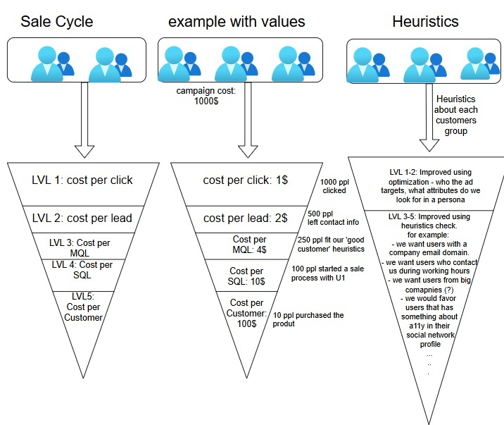
ICP Detection
How does it work?

Slide 16
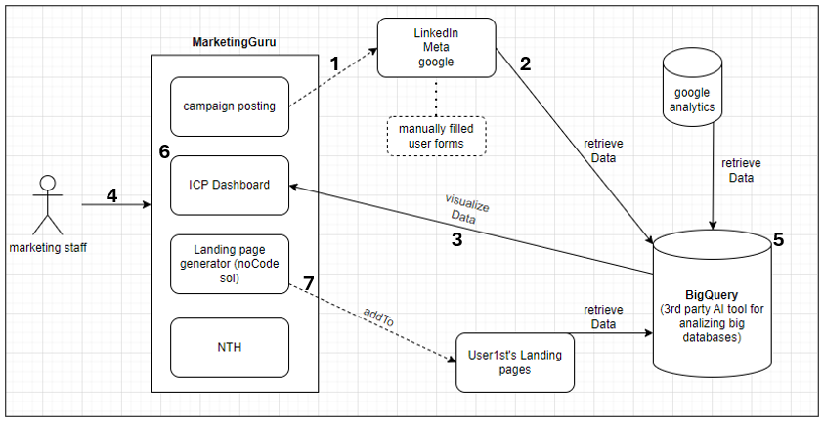
Risk Assesment

Slide 17
Risk Assesment
Risk Category | Risk Description | Mitigation Strategy
Integration for Cross-Platform Posting | Difficulty in implementing simultaneous posting across LinkedIn, Meta, and Google. | Test each platform individually in the PoC to resolve compatibility issues before full integration.
 |  | Test using platform-specific API calls and logging responses.
Data Retrieval Challenges | Difficulty in retrieving data from LinkedIn, Meta, Google Analytics, and other sources. | Establish connections to each source in the PoC to confirm data access and permissions.
 |  | Test using API response verification for each source and error handling for permission issues.
Data Presentation and Visualization | Difficulty in presenting data clearly for marketing teams, especially using Looker. | Create basic Looker visualizations in the PoC; gather feedback to refine dashboard functionality.
 |  | Test using sample data visualizations and feedback from end-users on usability and clarity.
Data Privacy and Security | Risk of handling personal user information securely. | Set up basic encryption and access controls in the PoC; test role-based permissions, third-party authentication mechanism (googleAuth, Facebook Login..)
 |  | Test using simulated access attempts by different roles and check for unauthorized data access attempts.
Complexity of Working with BigQuery | Learning curve and complexity in setting up BigQuery. | Run a small dataset through BigQuery in the PoC; familiarize team with its features.
 |  | Test using simple queries on sample data to assess performance and data handling efficiency.
Challenges in Identifying ICP | Difficulty in accurately identifying the Ideal Customer Profile (ICP). | Test ICP detection on sample data; refine methodology iteratively.
 |  | Test using sample customer data, analyzing ICP algorithm accuracy and refining based on results.
Implementing a NoCode Solution for Landing Pages | Challenges in building a flexible, user-friendly no-code tool for landing page creation. | Develop a basic no-code prototype in the PoC to test functionality and gather user feedback on usability.
 |  | Test using sample landing page builds and collect feedback from non-technical users.

Slide 18
Evaluation and Testing Plan
Unit Testing on individual classes and components and individual modules
QA testing
Acceptance Testing for system requirements
Manual UI/UX Testing with users
Test for security vulnerabilities
Test performance under high user load
Notes:
גל

Slide 19
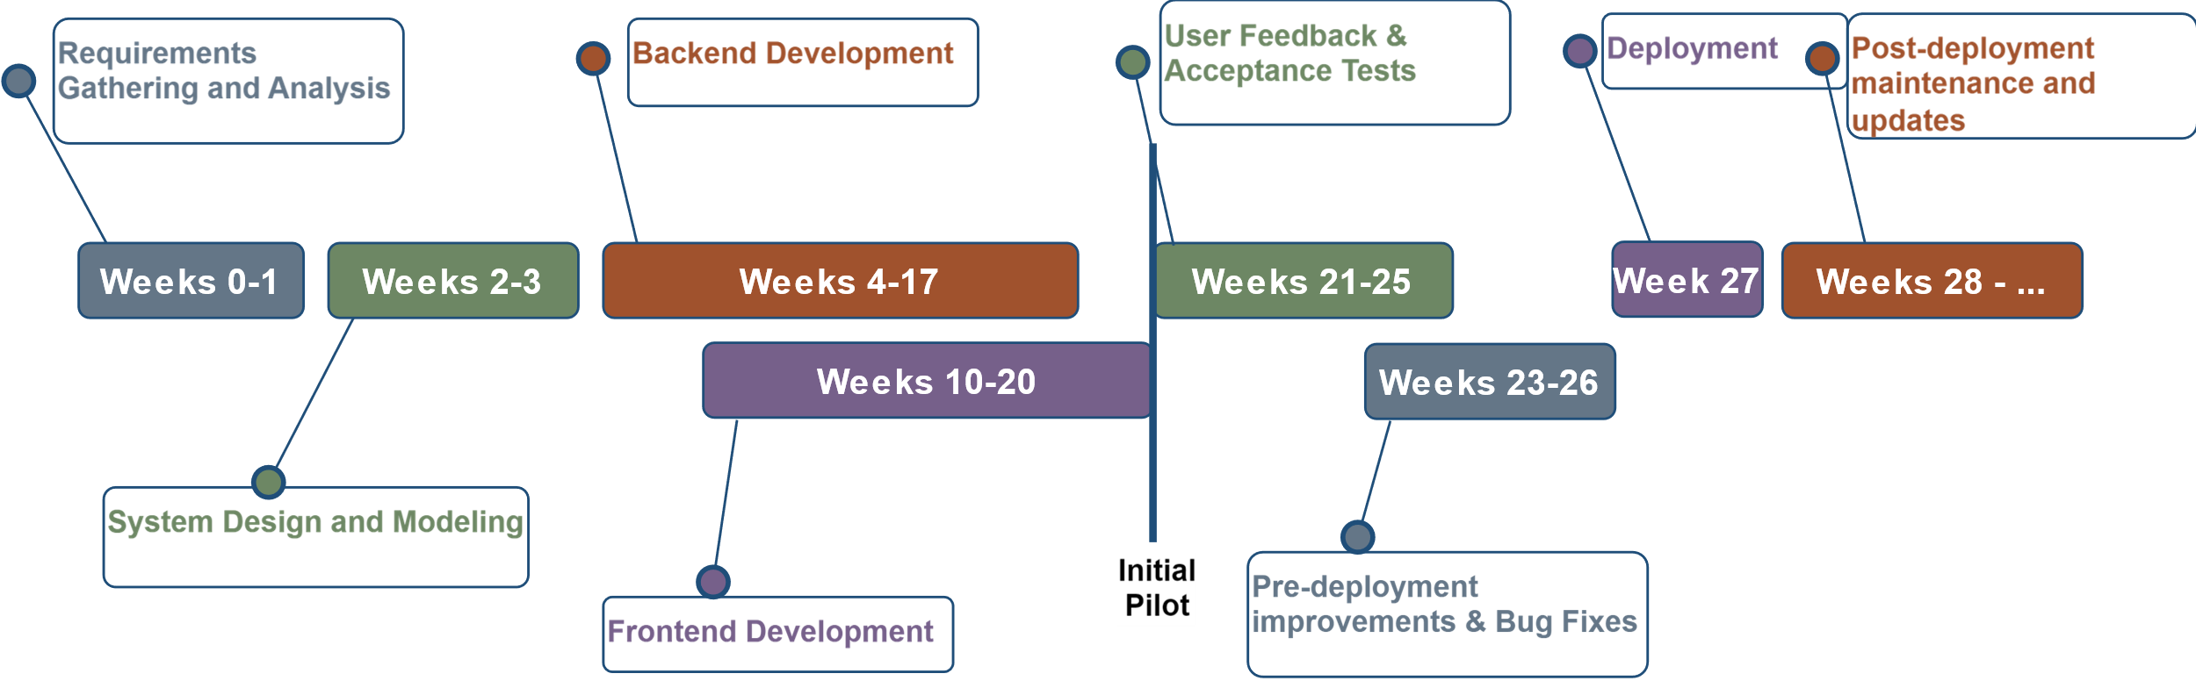
Project Timeline
Phase 1 complete
here
Phase 2 start

